Slide 2
About the LEP
Ian Barham, Partnership Director

Slide 3
A key function of LEPs is to..
..provide place-based economic expertise and insight to central and local government to help secure long-term inclusive growth at the local level.
Bucks LEP’s research team produces and analyses economic data and insight to:
Support strategy and policy development (local and national)
Inform project and programme design
Monitor and evaluation the impact of policy and investment
In 2021 Bucks LEP established the Buckinghamshire Economic Intelligence Observatory. A key element of which is the Observatory website. The aim of the website is to provide easy access to the latest economic data and insight to those who require it.
The website provides data and intelligence on a wide range of topics, including: economic output and productivity; business and innovation; jobs and skills; population; and infrastructure and energy.

Slide 4
Key economic trends
Saad Ehsan, Research Manager

Slide 5
The importance of a thriving economy
“A growing economy comes with improving economic conditions: faster wage growth, increasing employment, and stronger public finances. All of these can help facilitate improvements in the economic position of families [and individuals], particularly those on low-to-middle incomes.”
Source: The Resolution Foundation

Slide 6
The state of the UK economy
Stagnation
slow growth
weak productivity
Inflation
Labour shortages
Industrial action
The Growth Plan 2022 makes growth the government’s central economic mission, setting a target of reaching a 2.5% trend rate.

Slide 7
Buckinghamshire economy
£17.38 billion (GDP) (2020)
£ 29,731 (GDP per capita) (2020)
31,355 registered businesses (2022)
553,100 population (2021)

Slide 8
Buckinghamshire performed worse in the pandemic

Slide 9
The labour market and Claimant Count

Slide 10
Claimant Count rate by LEP area (January 2023)
When compared to other LEP areas, Buckinghamshire has the 11th lowest Claimant Count rate out of 38 LEP areas (up from having the fourth lowest rate pre-pandemic).
2.6% Claimant Count
Source: DWP, via NOMIS

Slide 11
Claimant count – January 2023

Slide 12
Labour Market trends
Recruitment difficulties
Fewer people in the labour market
Increased Job Postings
Job postings have continually increased in Buckinghamshire from Jan-Dec 2020 to Jan - Dec 2022 despite the pandemic.
Job Postings for nurses, programmers, sales, customer service, and other administrative occupations saw the biggest change.
Reduced workplace travel
By October 2022 (the last date for which data was collected) workplace travel was still 30% lower than pre-Covid.
Travel to railway and bus stations has also decreased and remains 23% below the baseline day.

Slide 13
Cost of doing business

Slide 14
summary
The cost of doing businesses has risen over recent years
A high proportion of respondents to the Buckinghamshire Business Barometer survey report rising costs in:
Energy
Goods / materials
Transportation
Wages
Business rates are often cited as a barrier to growth by small businesses

Slide 15
Bucks business barometer respondents reporting increases in costs – Q3 2022

Slide 16
Innovation and enterprise

Slide 17
Future growth
Key growth sectors (from an employment perspective) within Buckinghamshire over the next 10 years will be:
Construction - HS2, East West Rail, Aylesbury Garden Town related construction activity, and house building program.
Film and TV - expansion plans at Pinewood Studios, plus the continuing inward investment boom of the West of London Screen Cluster
Life sciences, health and social care - health needs of an ageing population and aftermath of the Covid-19 pandemic.
Space - linked to expansion of the Westcott Space Cluster.
High performance engineering - expansion of the Silverstone Enterprise Zone, and green technologies (400 companies) to combat climate change

Slide 18
Growing and declining sectors and occupations

Slide 19
Summary
Occupations that have grown to the greatest extent in Bucks over the last 10 years tend not to require a degree
Top three occupations in terms of increase in total employment between 2012 and 2022
Elementary admin and service
Caring personal service
Transport and machine drivers and operators
Top three occupations in terms of % increase in employment
Skilled agriculture
Transport and machine drivers and operators
Elementary trades

Slide 20
An Ageing Population
Source: ONS (2022)

Slide 21
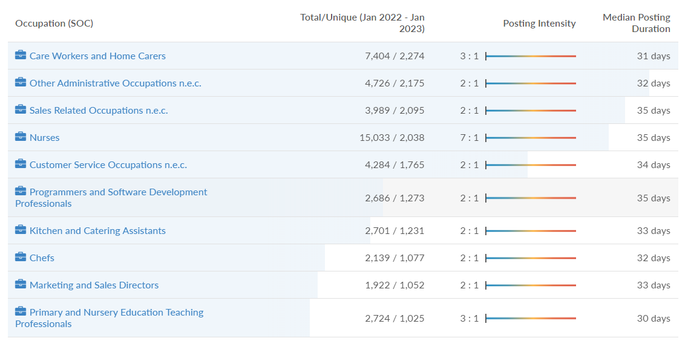
Top job postings
Source: Labour Insight, Burning Glass Technologies

Slide 22
Find out more / get involved
https://www.buckseconomy.co.uk/
Join our mailing list
Connect with the research team:
Caroline Hargrave– caroline.hargrave@buckslep.co.uk
James Moorhouse – james.moorhouse@buckslep.co.uk
Saad Ehsan – saad.ehsan@buckslep.co.uk
Buckinghamshire Local Enterprise Partnership
@BucksLEP

